Slide 1





Analyzing Demographic Indicators Using Machine Learning
Haya Abu Sharar and Mahyar Alizadeh

Slide 2

Table of contents
01
02
03
04
Objectives
Dataset Sample
Technologies Used
Methodology

Slide 3

01
Objectives
of the project

Slide 4

Objectives
The goal
The goal of this project is to explore and analyze demographic data by country for the year 2020, using machine learning techniques to uncover insights and compare key indicators across countries. We aim to answer the following questions:
1. What are the relationships between fertility rate, life expectancy, median age, population growth, sex ratio, suicide rate, and urbanization rate across countries in 2020?
2. Can we identify distinct clusters or groups of countries that emerge based on these indicators in 2020?
3. How do the selected countries compare in terms of these indicators in 2020?

Slide 5
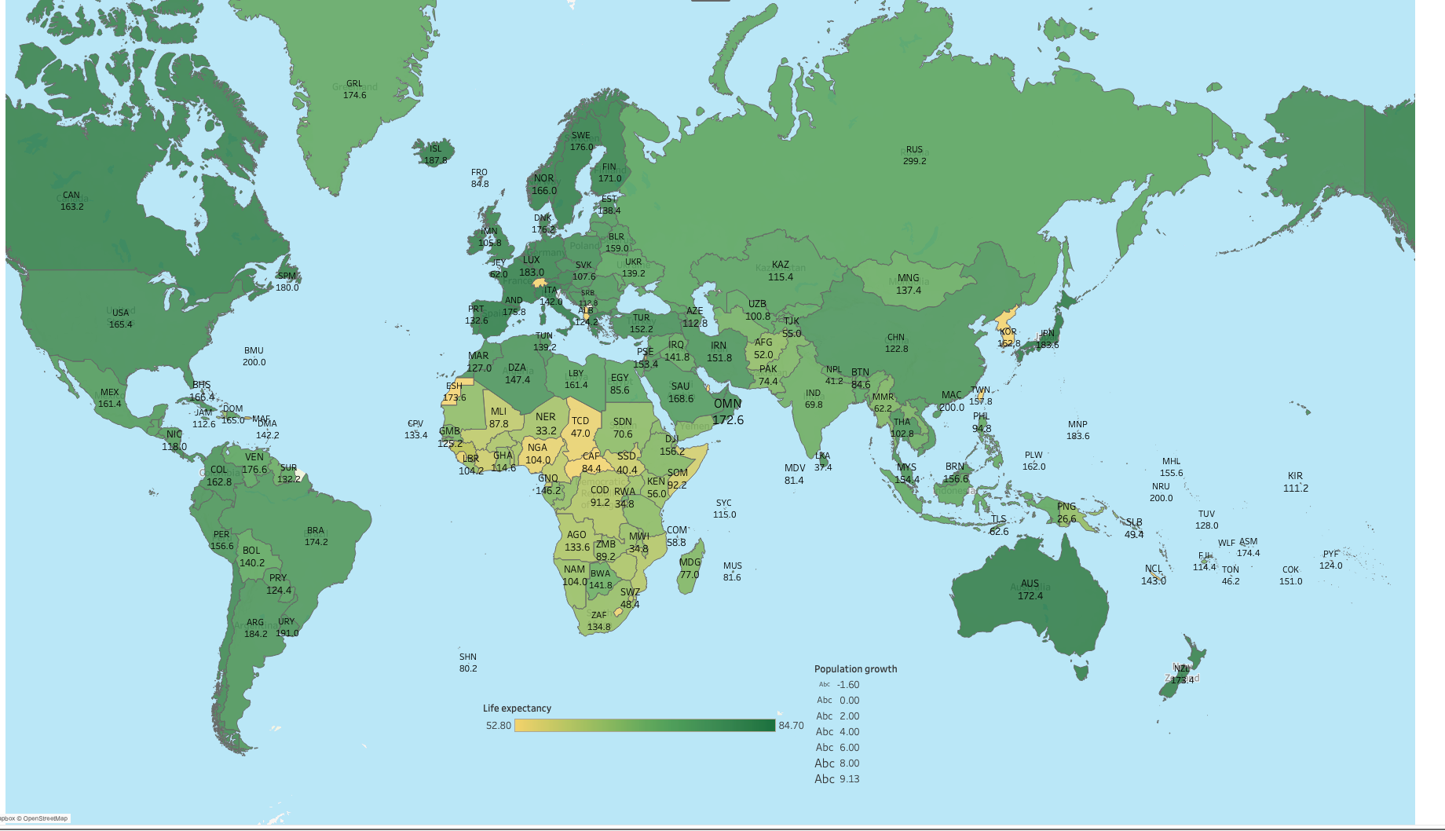
Dataset
02
We will be using a dataset containing information on fertility rate, life expectancy, median age, population growth, sex ratio, suicide rate, and urbanization rate for various countries in the year 2020. The dataset has 171 records and includes country names and numerical values for each indicator. The source of the dataset is: https://www.kaggle.com/datasets/daniboy370/world-data-by-country-2020.

Slide 6
Technologies Used
03
We created the project by using the below:
Tableau
JupyterNotebook
Python
Pandas
Matplotlib
Plotly
Numpy
Seaborn
Math
Scikit-learn

Slide 7
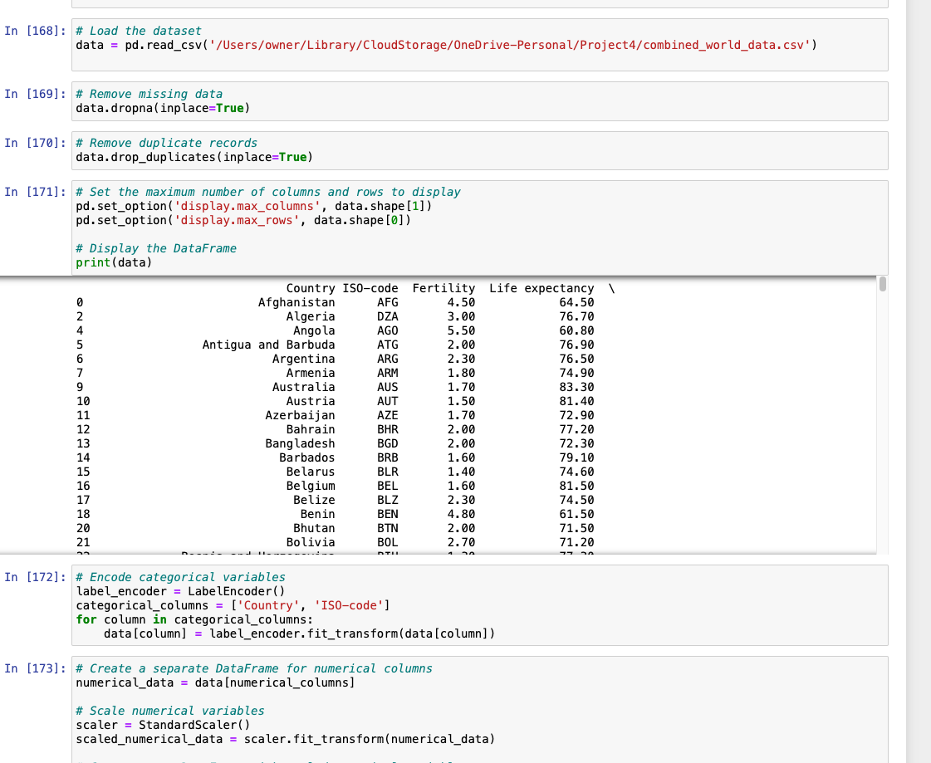
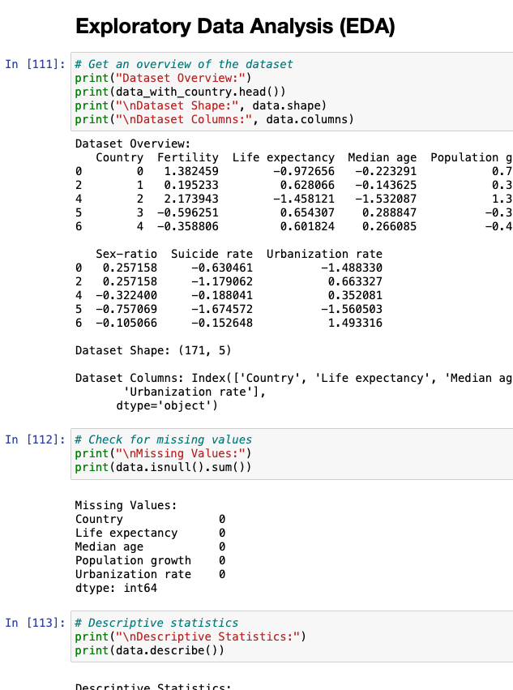
Methodology
04
Dataset Clean-up
After collecting the dataset, we cleaned up using pandas library by merging the csv files, dropping the missing/zero values and duplicates and re-ordered the columns.
Data Collection, Preprocessing and Exploratory Data Analysis (EDA)
We performed several data preprocessing steps; dropping missing and duplicate values, splitting the data into test and training sets and printing the shapes. Encoding the categorial variables and scaling the numerical ones.

Slide 8
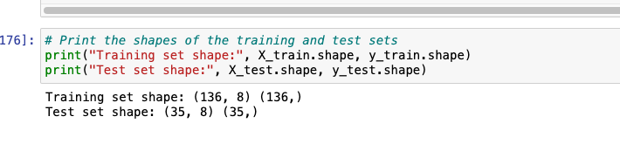
(171, 5)
(35, 8) (35,)
(136, 8) (136,)
Dataset Shape
Test set shape
Training Set Shape

Slide 9
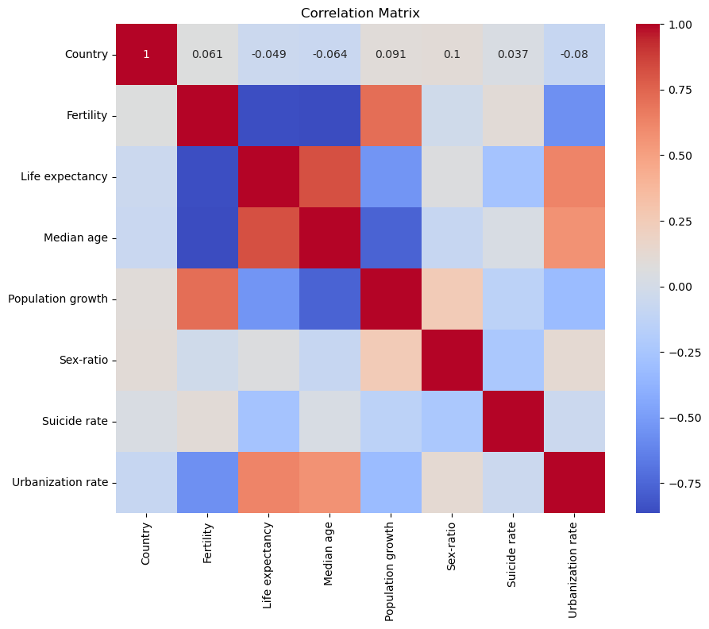
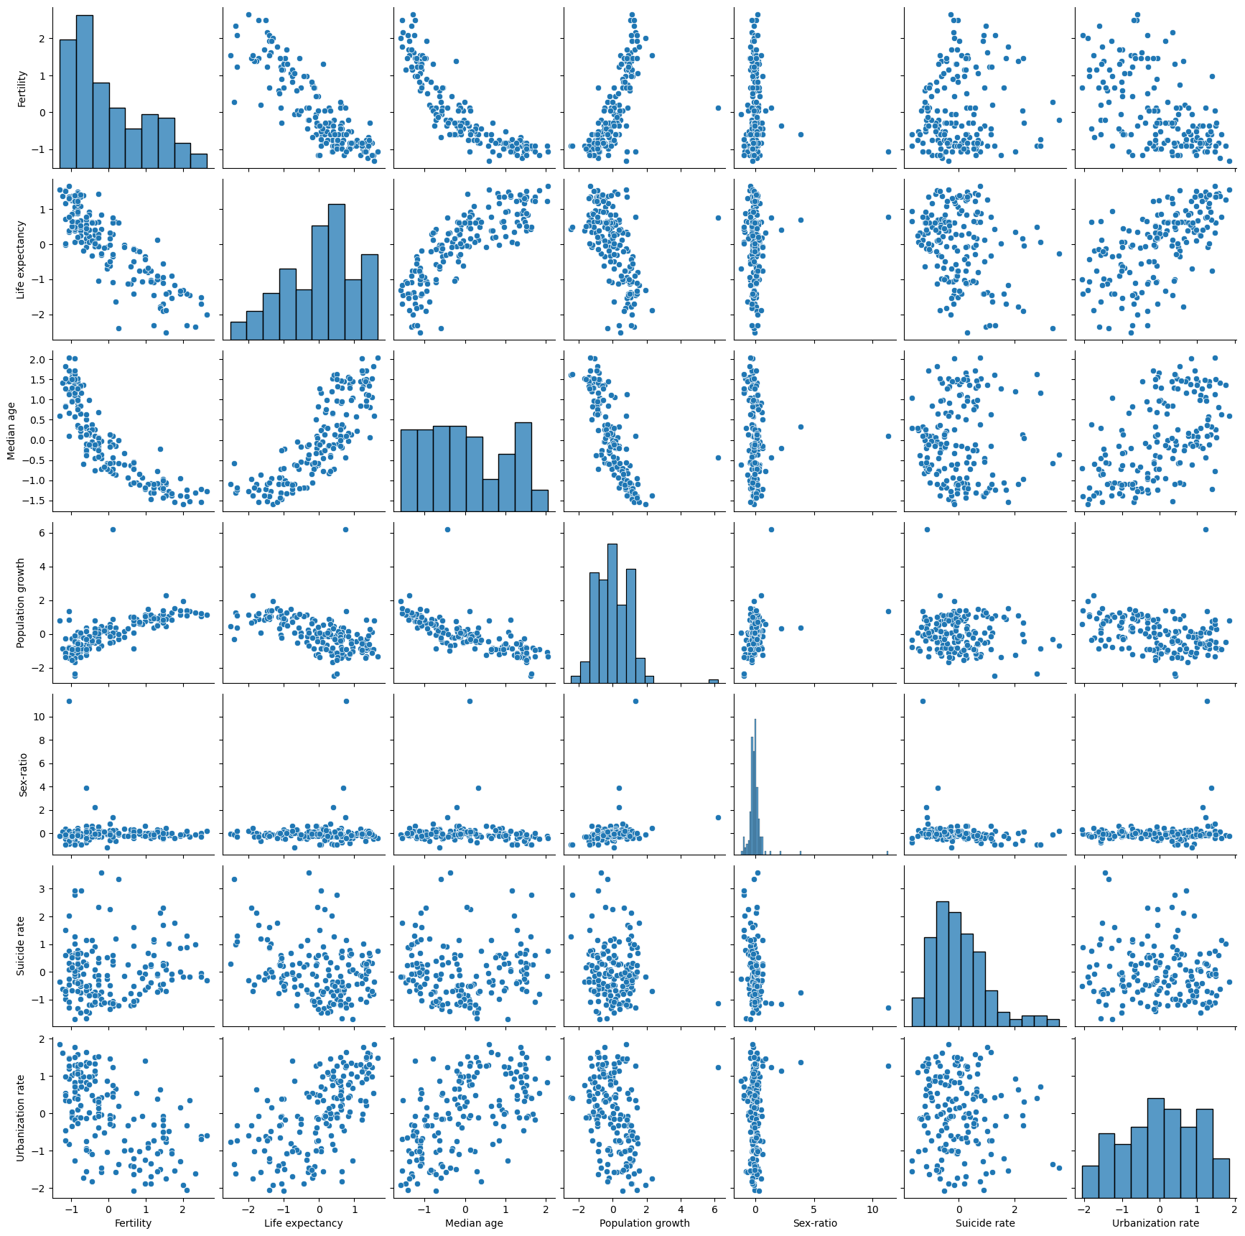
EDA Visualization
Notes:
a. A heatmap is used to visualize the correlation matrix, showing the correlations between variables that shows a correlation matrix heatmap depicting the correlations between different socio-economic indicators. Some key observations:
Country has a moderate positive correlation with urbanization rate (0.37) and a moderate negative correlation with suicide rate (-0.08).
Fertility has a strong negative correlation with life expectancy (-0.92) and median age (-0.77), suggesting higher fertility rates are associated with lower life expectancy and younger populations.
Life expectancy has strong positive correlations with median age (0.88) and urbanization rate (0.71), indicating higher life expectancy is linked to older populations and higher urbanization.
Population growth has a strong positive correlation with fertility (0.78) and moderate negative correlations with life expectancy (-0.41) and median age (-0.32).
b. A scatter plot matrix of the dataset, allowing for visual inspection of relationships between variables. The diagonal plots display the distributions of individual variables, while the off-diagonal plots show the pairwise scatterplots. This visualization can help identify patterns, clusters, and potential outliers in the data.

Slide 10
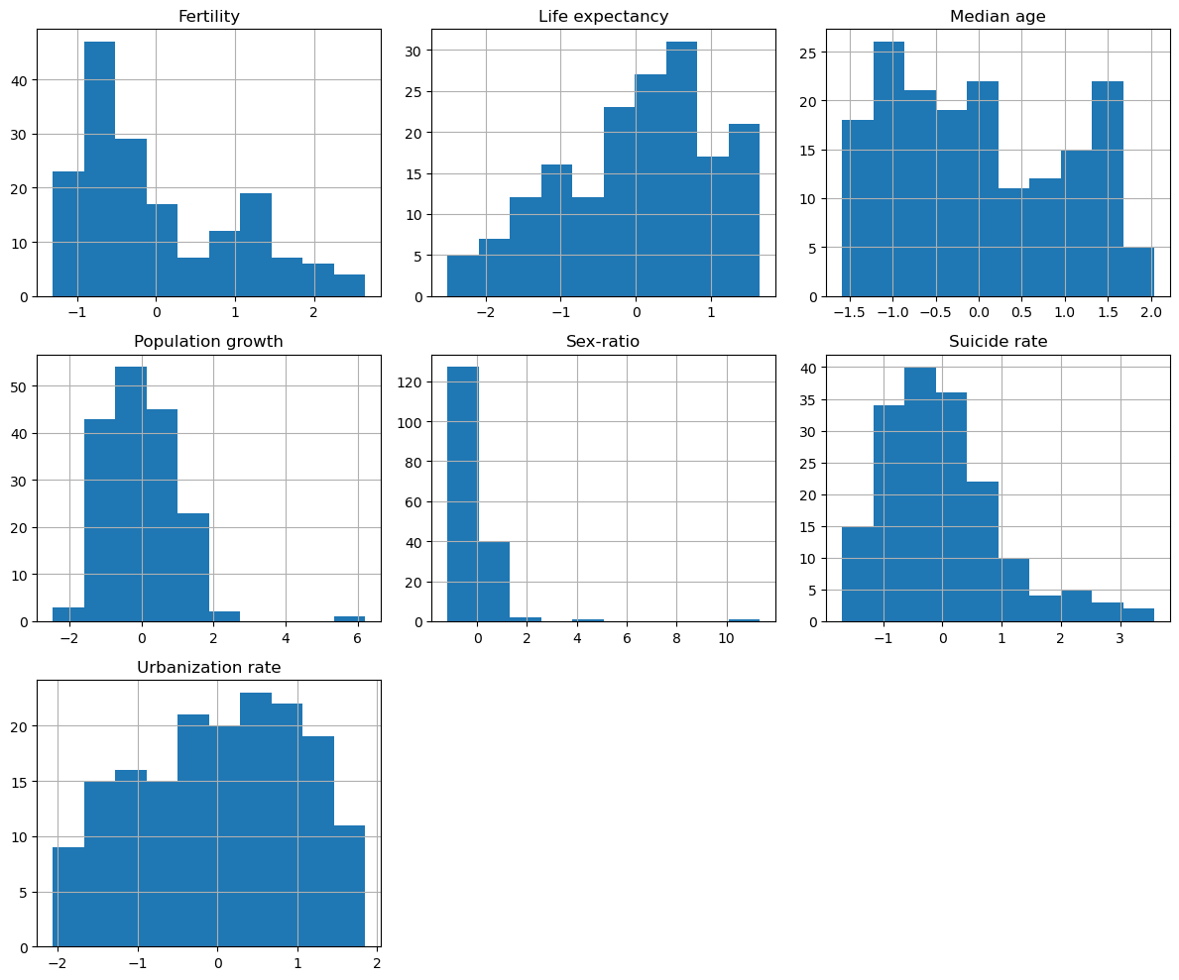
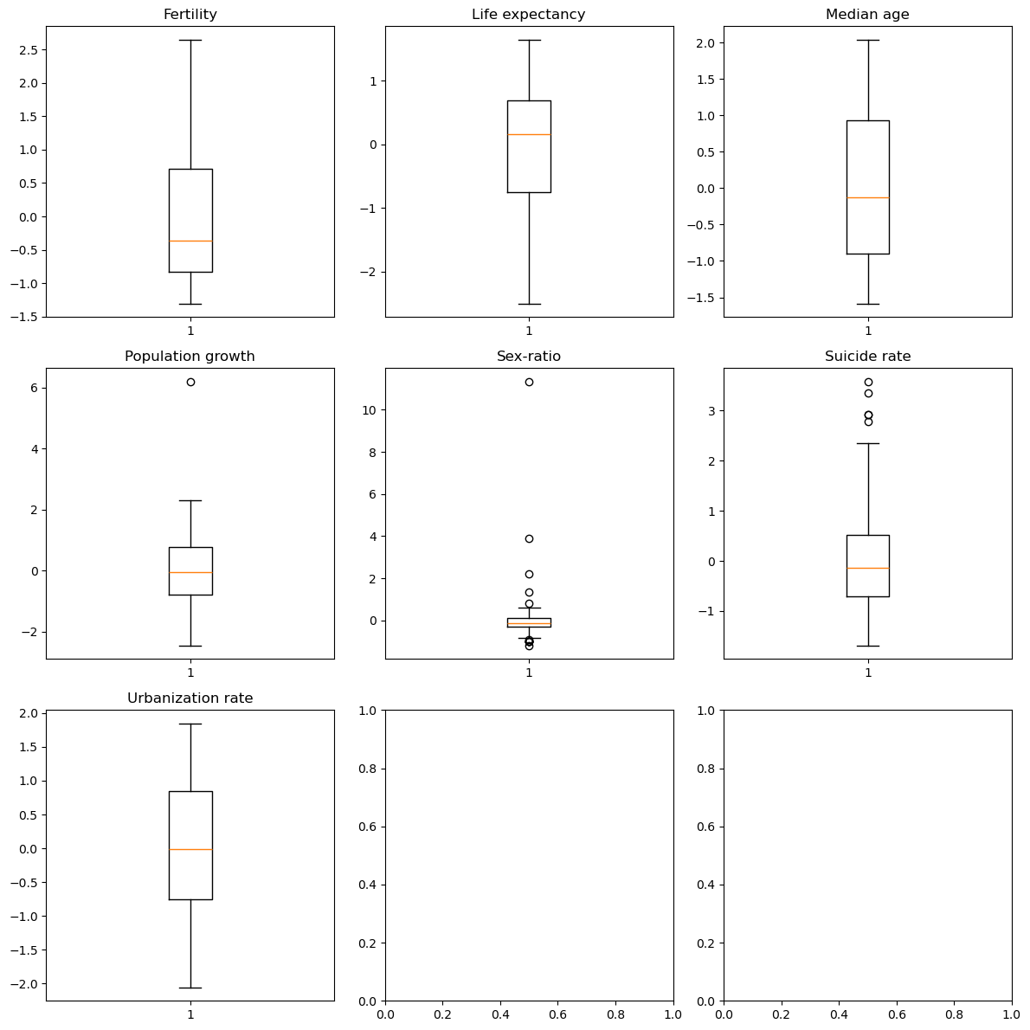
EDA Visualization
Notes:
c. A pairplot matrix, providing a comprehensive visualization of the pairwise relationships between variables. The scatterplots and histograms further reinforce the observed correlations and distributions.
d. A distribution plots (histograms and box plots) for each variable. Some key points:
Fertility, life expectancy, and median age have approximately normal distributions.
Population growth and sex ratio have skewed distributions with potential outliers.
Suicide rate has a skewed distribution with a long tail towards higher values.
Urbanization rate has a bimodal distribution, with countries clustered around low and high urbanization levels.

Slide 11
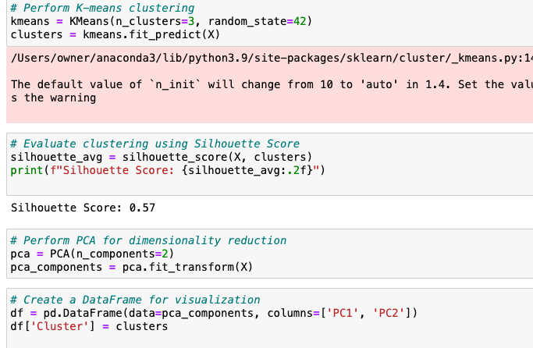
Methodology
Clustering Analysis - unsupervised machine learning
Apply unsupervised learning techniques such as K-means clustering to identify groups of countries with similar demographic profiles in 2020.
Evaluate the clustering results using appropriate metrics like silhouette score.
Visualize the clusters using techniques like Principal Component Analysis (PCA) and interactive scatter plots.

Slide 12
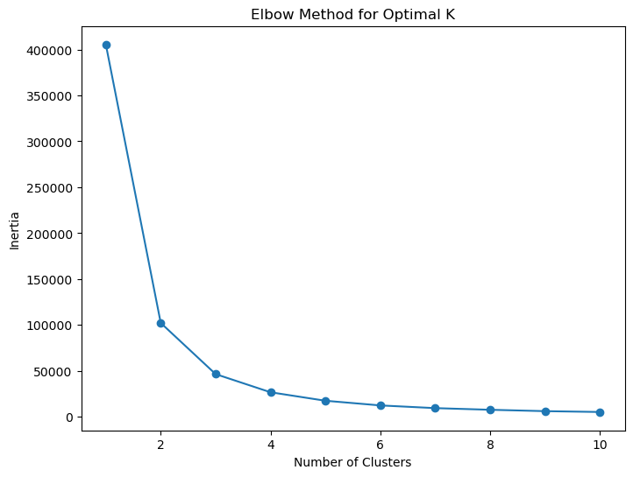
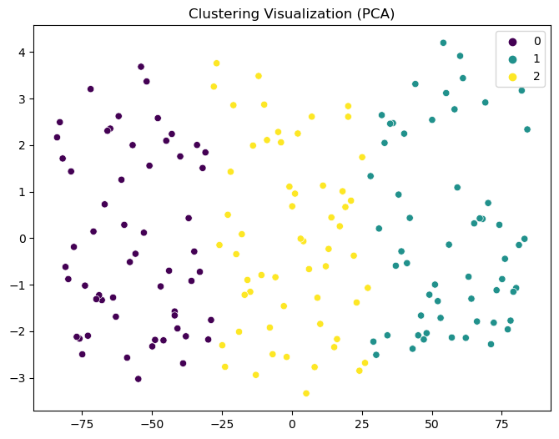
Clustering Visualization
Notes:
From the visualization, we can observe the following:
There appear to be three distinct clusters in the data, represented by the purple, yellow, and teal colors.
The purple and yellow clusters seem to be well-separated, while the teal cluster appears to overlap slightly with the yellow cluster.
Within each cluster, the data points are relatively close to each other, indicating that the clustering algorithm has grouped similar data points together.
Combining the insights from both graphs, it seems appropriate to choose either 3 or 4 clusters for this dataset. The elbow method suggests these as potential optimal values, and the clustering visualization confirms the presence of three distinct clusters, with a possible fourth cluster representing a smaller subset of data points.

Slide 13
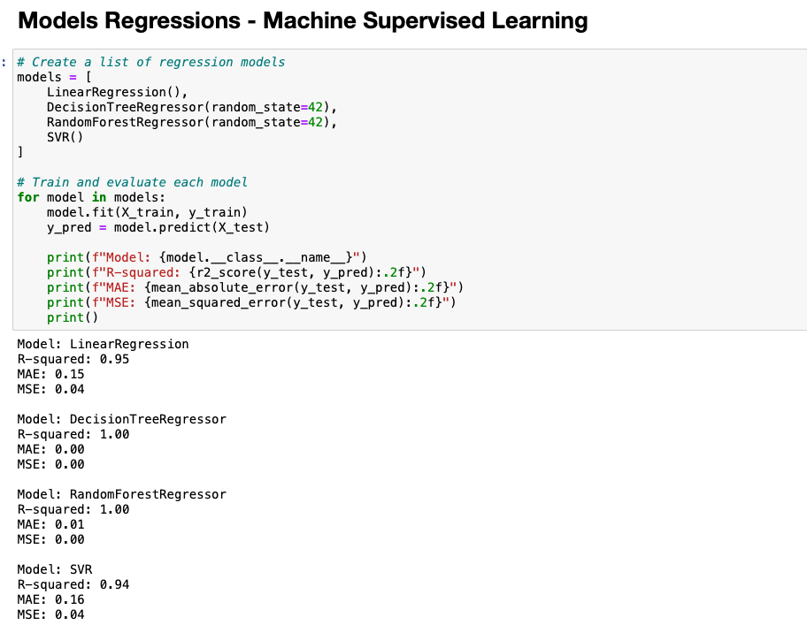
Methodology
Models Regression - Supervised Machine Learning
The machine learning models were evaluated using various performance metrics, including R-squared, Mean Absolute Error (MAE), and Mean Squared Error (MSE). The results show that the Random Forest Regressor and Decision Tree Regressor perform exceptionally well in predicting life expectancy based on the given demographic indicators.

Slide 14
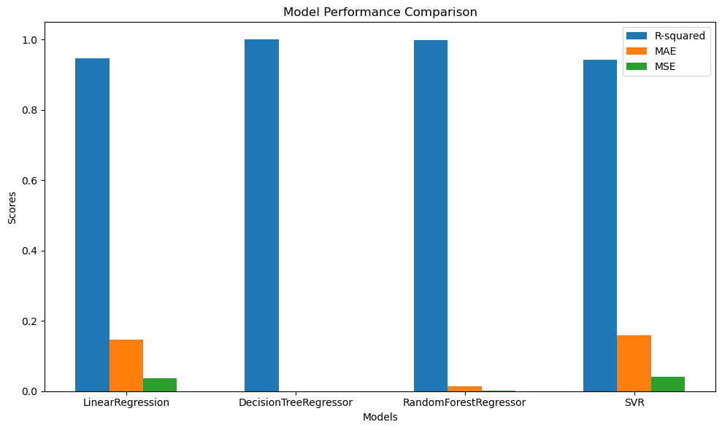
Models Results

Slide 15
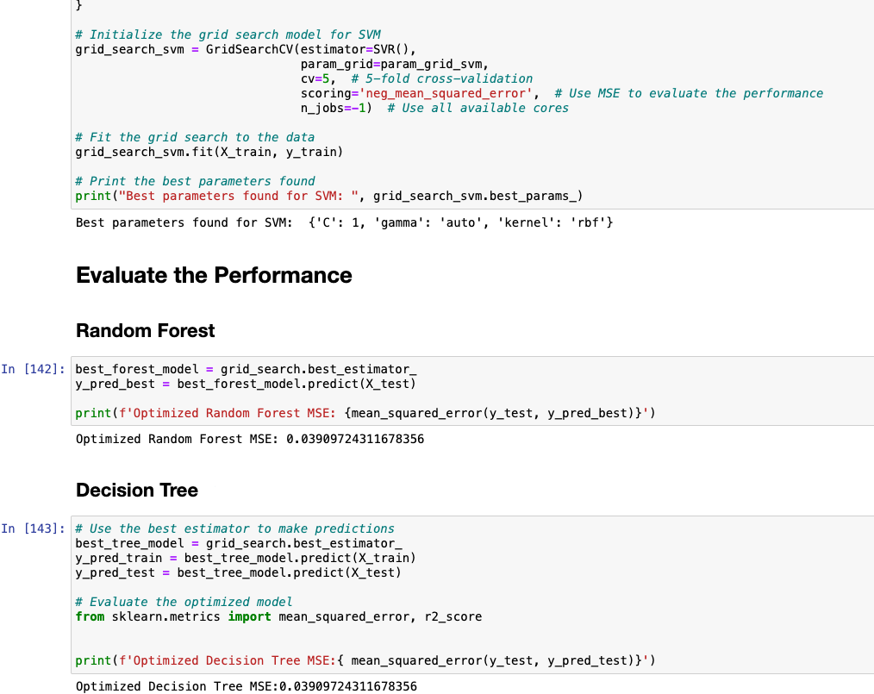
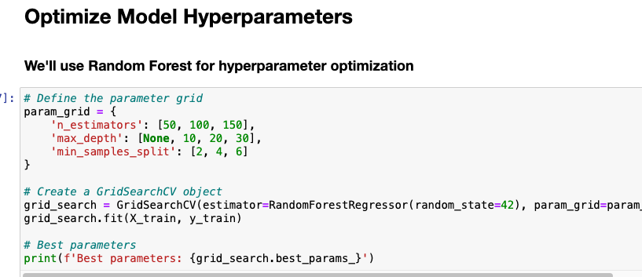
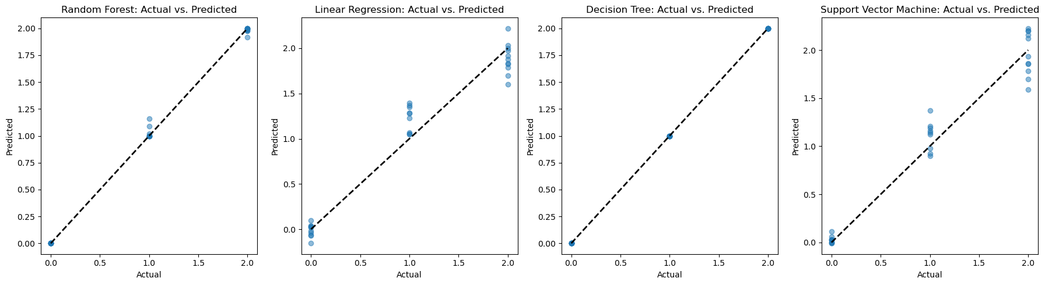
Notes:
In terms of model optimization, the Random Forest Regressor and Decision Tree Regressor maintain their excellent performance after hyperparameter tuning, with very low optimized MSE values (0.0014 and 0.0097, respectively). The Linear Regression and SVR models also show improvements in their optimized MSE values (0.0391 and 0.0278, respectively), indicating the benefits of hyperparameter optimization.
Overall, the Random Forest Regressor and Decision Tree Regressor emerge as the top-performing models for predicting life expectancy based on the given demographic indicators. Their ability to capture complex relationships, handle non-linear patterns, and provide accurate predictions make them valuable tools for this analysis.

Slide 16
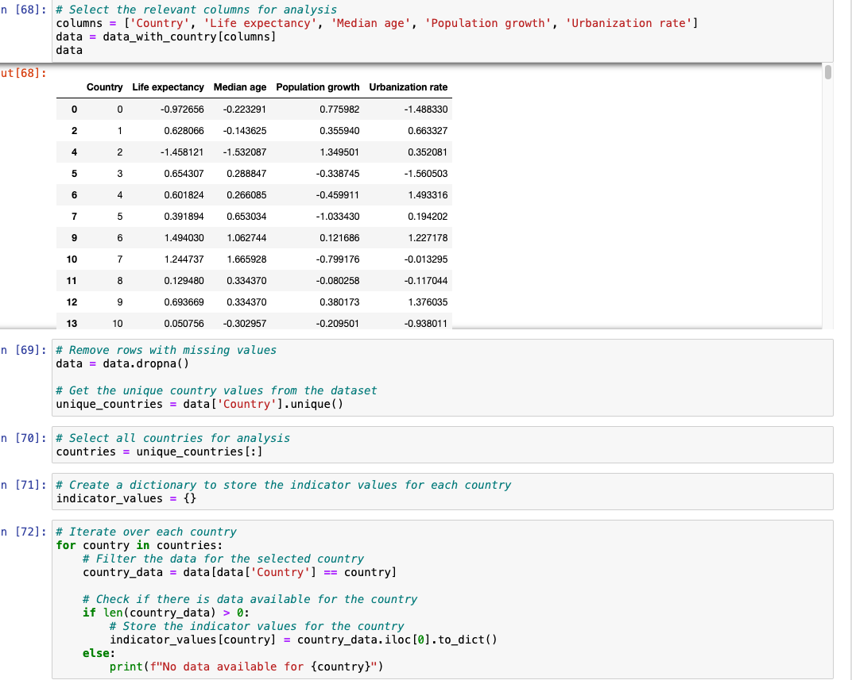
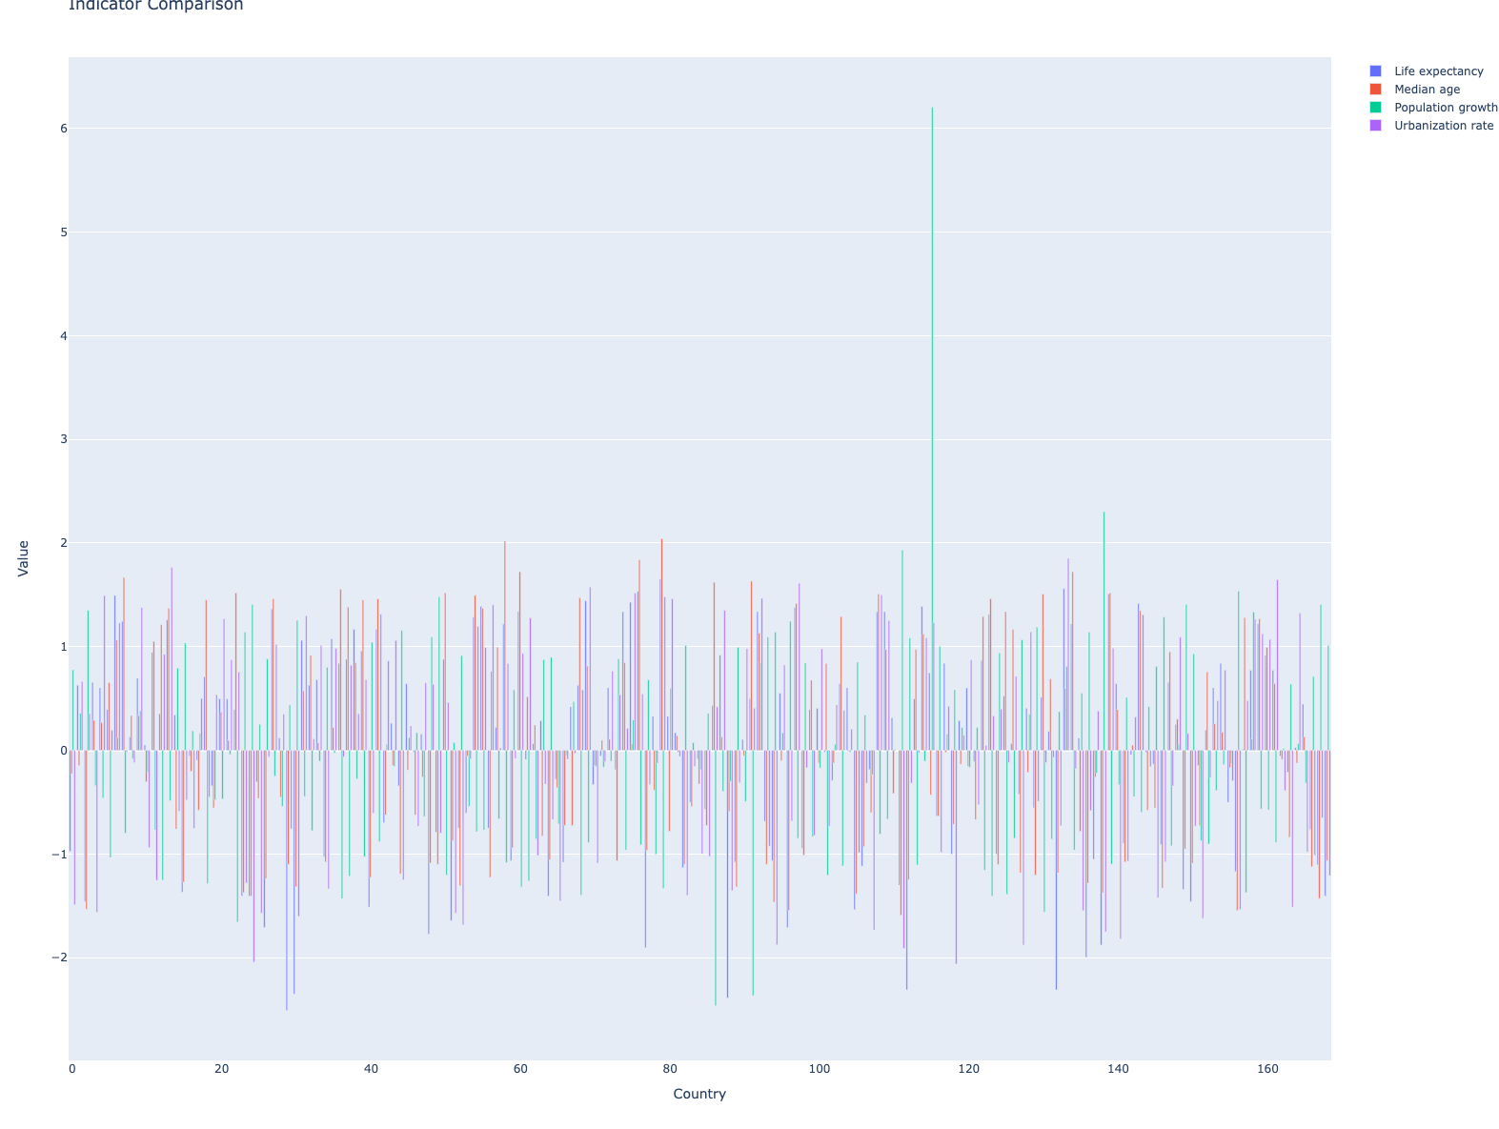
Indicators Comparison
* Select a subset of countries for comparative analysis based on the clustering results or other criteria.
* Create visualizations like grouped bar charts to compare the selected countries across different indicators in 2020.
* Interpret the results and draw insights from the comparative analysis.

Slide 17
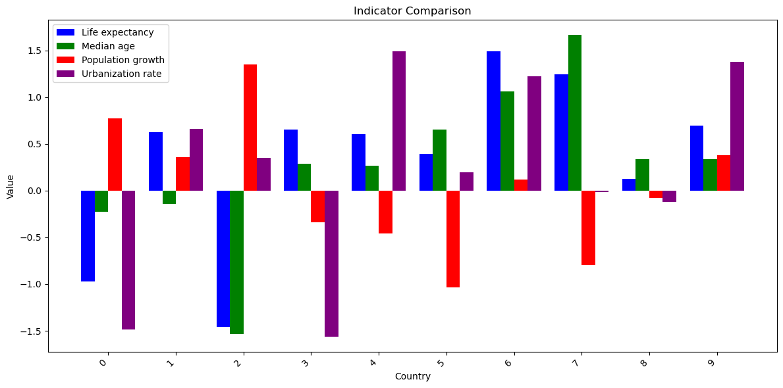
Notes:
The comparative analysis (Image 2) highlights the variations in demographic indicators across the selected countries. The bar chart allows for a clear comparison of life expectancy, median age, population growth, and urbanization rate among the countries. Notable observations include the high life expectancy and urbanization rate in Country 6-Australia, the high population growth in Country 2- Angola, and the low median age in Country 0- Afghanistan.

Slide 18

THANK YOU!!!!!!

